Slide 1
Get Started on Amazon FreeRTOS
IOT217
Richard Kang
Technical Account Manager
AWS/Enterprise Support

Slide 2
Steps
Step 1 - Create AWS IoT Thing
Step 2 - Create Cloud9 instance
Step 3 - Configure Cloud9 environment
Step 4 - Download Amazon FreeRTOS
Step 5 - Update Amazon FreeRTOS credentials
Step 6 – Update Wi-Fi and AWS IoT Endpoint
Step 7 - Compile Amazon FreeRTOS
Step 8 – Download to local computer to flash to ESP32

Slide 3
Step 1 - Create AWS IoT Thing
Login to AWS IoT Console https://console.aws.amazon.com/iot
Create an IoT Thing in Manage -> Things -> Create
Choose Create a single thing
Use a name, for example, esp32_reinvent
Choose Next
Choose Create certificate
Download all the certificates
Choose Activate
Choose Attach a policy – let’s talk about IoT Policy
Go to Settings and make a note of Custom endpoint

Slide 4
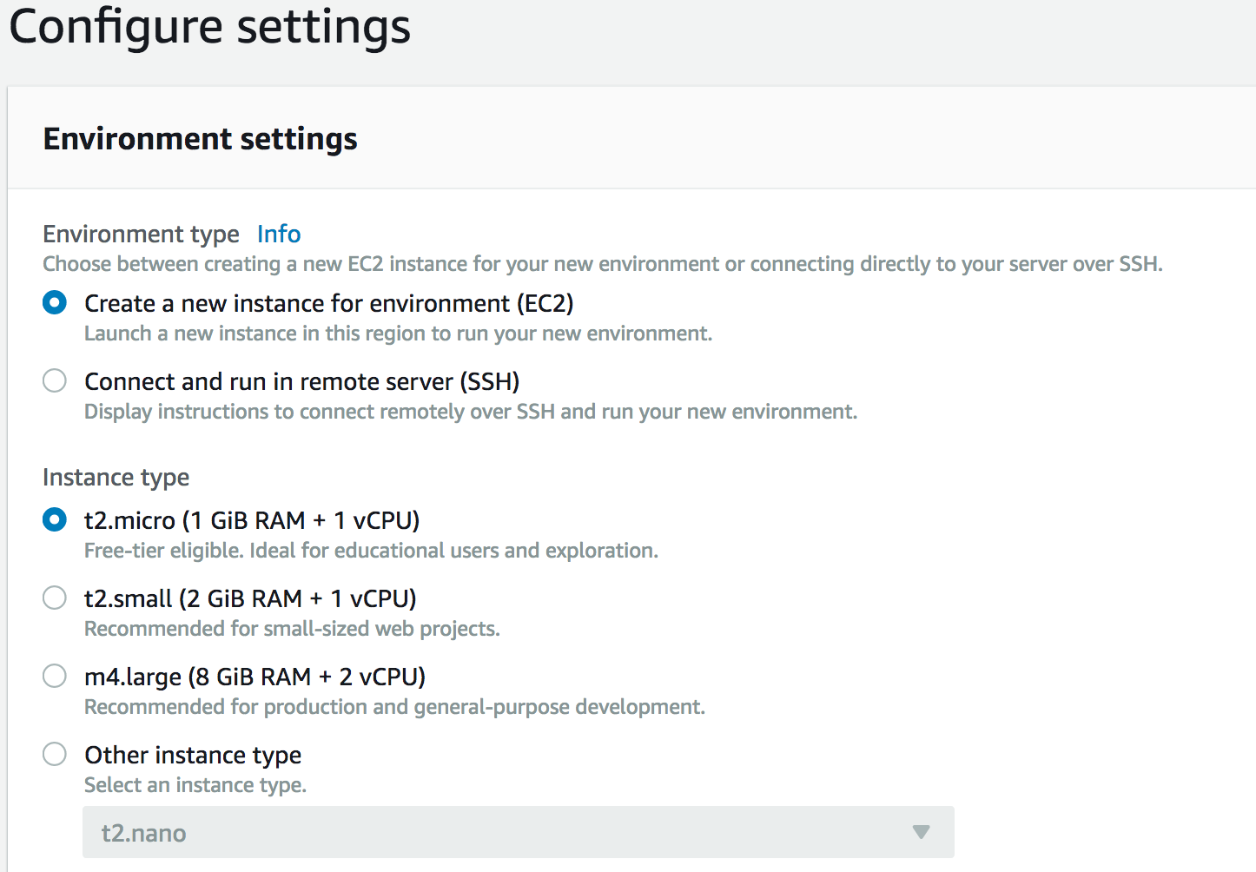
Step 2 - Create Cloud9 instance
Goto https://console.aws.amazon.com/cloud9
Choose Create environment
Enter a name, such as esp32-xtensa-c9, choose Next step
Accept the default options
Create a new instance for environment (EC2)
t2.micro
Choose Next step, Choose Create environment

Slide 5
Step 3 - Configure Cloud9 environment
sudo yum -y update
sudo yum groupinstall -y"Development tools”
Install GNU perfect, hash function generator
sudo yum install –y gperf
sudo pip install serial
Download and create xtensa toolchain
cd ~
wget https://dl.espressif.com/dl/xtensa-esp32-elf-linux64-1.22.0-73-ge28a011-5.2.0.tar.gz
tar xf xtensa-esp32-elf-linux64-1.22.0-73-ge28a011-5.2.0.tar.gz
mkdir –p ~/bin
ln -s ~/xtensa-esp32-elf/bin/* ~/bin/

Slide 6
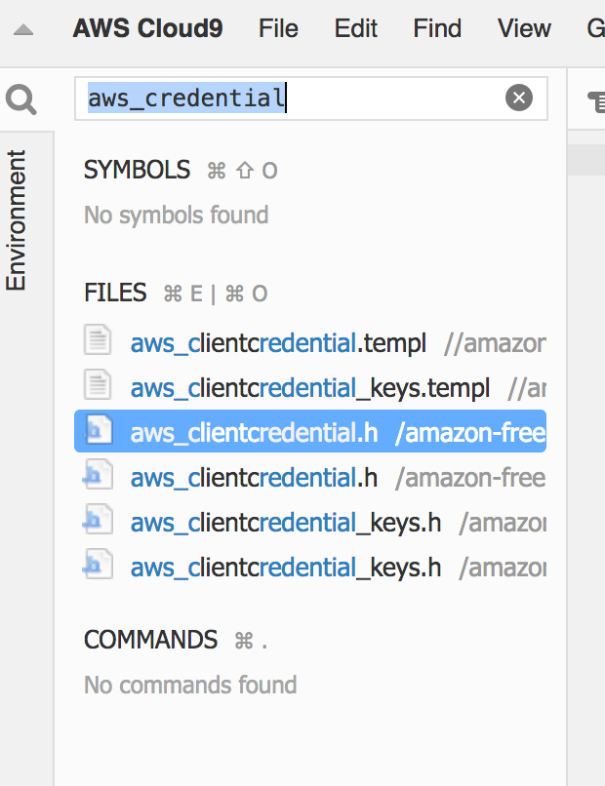
Step 4 - Download Amazon FreeRTOS
cd ~/environment
git clone https://github.com/aws/amazon-freertos.git
In the Cloud9 search windows, enter aws_credential
Choose aws_credential_keys.h

Slide 7
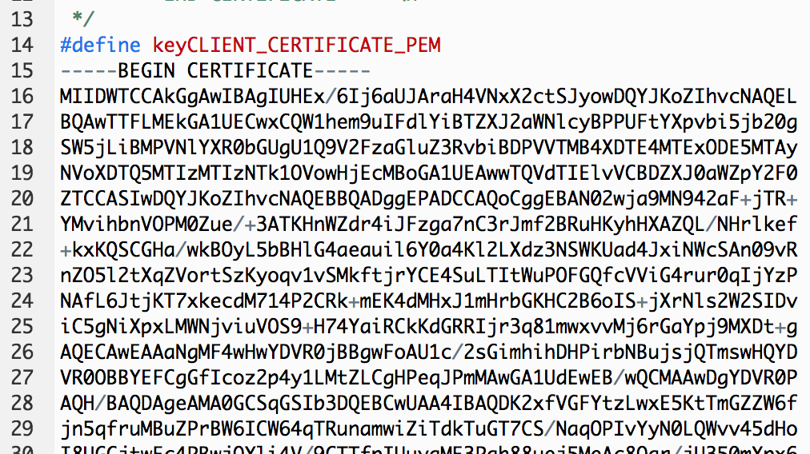
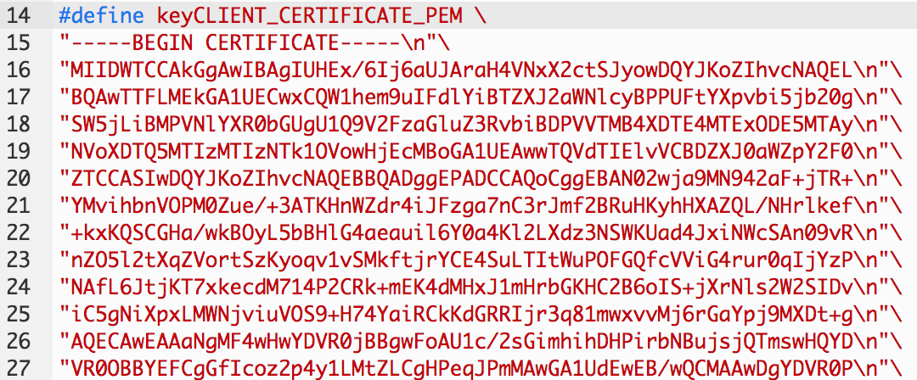
Step 5 - Update Amazon FreeRTOS credentials
Open the certificate, e.g.
$ cat 65b6a8b9b4-certificate.pem.crt
Copy the contents and paste in #define keyCLIENT_CERTIFICATE_PEM
Place the cursor
Choose Tools, Toggle Macro Recording
Record the macro
Go to the beginning of the line, enter “
Go to the end of the line, enter \n”\
Stop Macro recording
Replay the macro for the rest of the certificate

Slide 8
Step 6 – Update Wi-Fi and AWS IoT Endpoint
In the Cloud9 search windows, enter aws_credential
Choose aws_credential_keys.h
Edit the following to the correct values
clientcredentialMQTT_BROKER_ENDPOINT
clientcredentialIOT_THING_NAME
clientcredentialWIFI_SSID
clientcredentialWIFI_PASSWORD

Slide 9
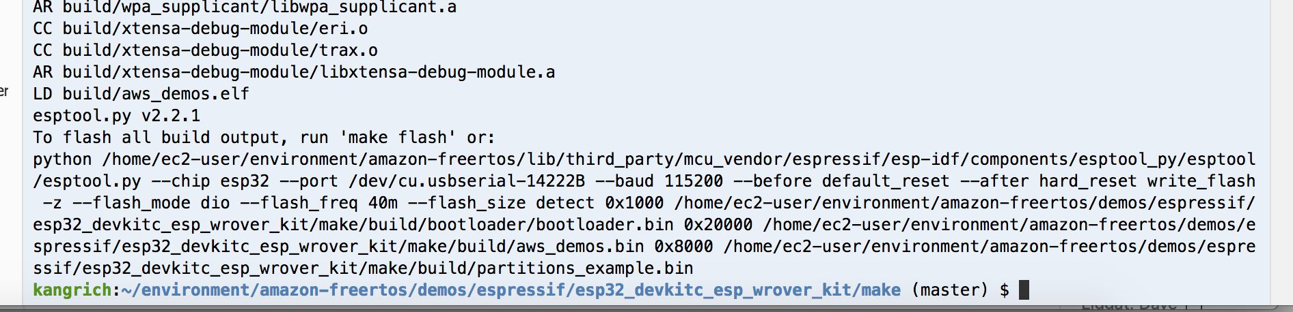
Step 7 - Compile Amazon FreeRTOS
cd ~/environment/amazon-freertos/demos/espressif/esp32_devkitc_esp_wrover_kit/make
Run make

Slide 10
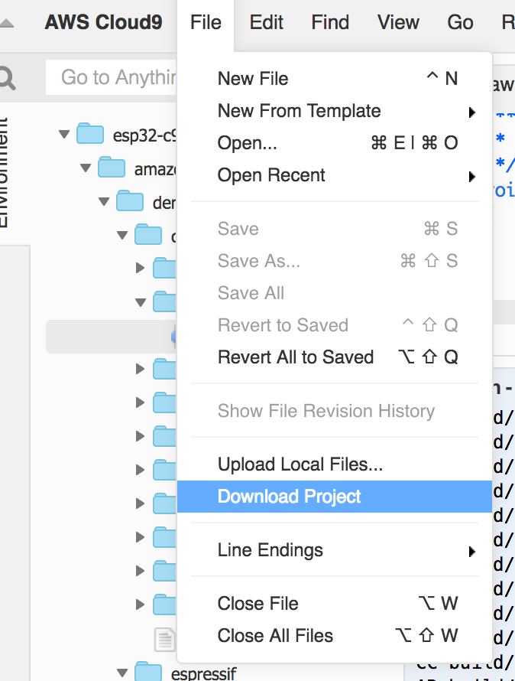
Step 8 – Download to local computer to flash to ESP32
Download Cloud9 project
Extract the compressed file
The compiled binary is in amazon-freertos/demos/espressif/esp32_devkitc_esp_wrover_kit/make/build/aws_demos.bin
Install the esptool to flash the image
sudo pip install esptool
esptool.py -p /dev/cu.SLAB_USBtoUART -b 115200 write_flash --flash_mode dio --flash_size 2MB 0x20000 amazon-freertos/demos/espressif/esp32_devkitc_esp_wrover_kit/make/build/aws_demos.bin
miniterm.py /dev/cu.SLAB_USBtoUART 115200

Slide 11
Amazon FreeRTOS references
Amazon FreeRTOS Documentation
https://docs.aws.amazon.com/freertos/index.html#lang/en_us
Connect Microcontroller-Based Devices to the Cloud with Amazon FreeRTOS and Espressif ESP32
https://aws.amazon.com/blogs/apn/connect-microcontroller-based-devices-to-the-cloud-with-amazon-freertos-and-espressif-esp32/

